Slide 1
LRU Page Replacement.
SACHIT SHARMA 2021A1R027
GAUTAM KUMAR 2021A1R005
HIMANSHU SHARMA 2021A1R012

Slide 2
INTRODUCTION
We are given the total possible page numbers that can be referred to. We are also given a cache (or memory) size (The number of page frames that the cache can hold at a time). The LRU caching scheme is to remove the least recently used frame when the cache is full and a new page is referenced which is not there in the cache.

Slide 3
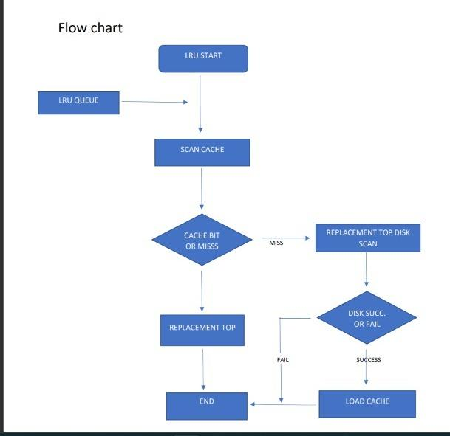
FLOWCHART:
MISS
HIT
FAIL SUCCESS

Slide 4
ALGORITHM
Let us say s that is the main memory's capacity to hold pages and pages is the list containing all pages currently present in the main memory.
Iterate through the referenced pages.
If the current page is already present in pages:
1.Remove the current page from pages.
2.Append the current page to the end of pages.
3.Increase page hits.
Else:
Increment page faults.
If pages contains less pages than its capacity s:
Append current page into pages.
Else:
Remove the first page from pages.
Append the current page at the end of pages.
Return the number of pages hits and page faults.

Slide 5
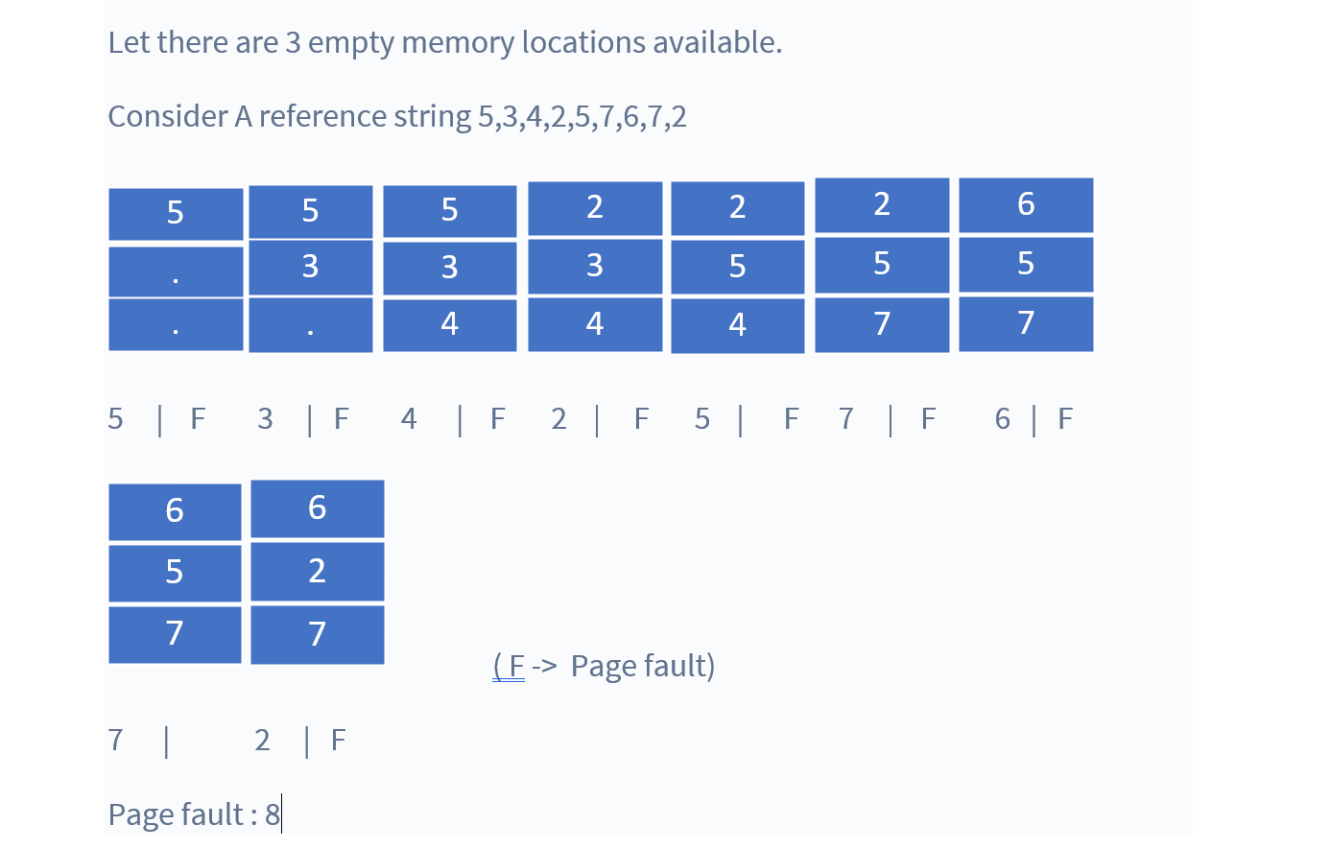
EXAMPLE:

Slide 6
C PROGRAM CODE:
#include<stdio.h>
int findLRU(int time[], int n){
int i, minimum = time[0], pos = 0;
for(i = 1; i < n; ++i){
if(time[i] < minimum){
minimum = time[i];
pos = i;
}
}
return pos;
}
int main()
{
int no_of_frames, no_of_pages, frames[10], pages[30], counter = 0, time[10], flag1, flag2, i, j, pos, faults = 0;
printf("Enter number of frames: ");
scanf("%d", &no_of_frames);
printf("Enter number of pages: ");
scanf("%d", &no_of_pages);
printf("Enter reference string: ");
for(i = 0; i < no_of_pages; ++i){
scanf("%d", &pages[i]);
}
for(i = 0; i < no_of_frames; ++i){
frames[i] = -1;
}
for(i = 0; i < no_of_pages; ++i){
flag1 = flag2 = 0;

Slide 7
CONT…
for(j = 0; j < no_of_frames; ++j){
if(frames[j] == pages[i]){
counter++;
time[j] = counter;
flag1 = flag2 = 1;
break;
}
}
if(flag1 == 0){
for(j = 0; j < no_of_frames; ++j){
if(frames[j] == -1){
counter++;
faults++;
frames[j] = pages[i];
time[j] = counter;
flag2 = 1;
break;
}
}
}
if(flag2 == 0){
pos = findLRU(time, no_of_frames);
counter++;
faults++;
frames[pos] = pages[i];
time[pos] = counter;
}

Slide 8
CONT…
printf("\n");
for(j = 0; j < no_of_frames; ++j){
printf("%d\t", frames[j]);
}
}
printf("\n\nTotal Page Faults = %d", faults);
return 0;
}

Slide 9
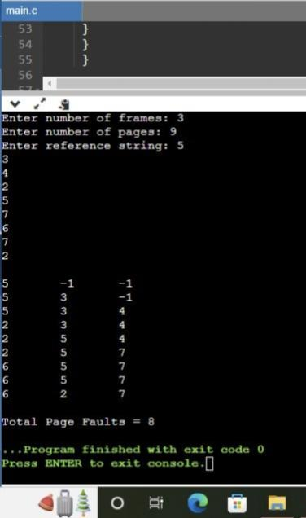
OUTPUT

Slide 10

EMAIL
2021a1r027@mietjammu.in
2021a1r005@mietjammu.in
2021a1r012@mietjammu.in

